Slide 1


Monolithic Power Systems®
Testplan Export Tool

Slide 2
Rev | Date | Description of Change | Author
0.0 | 7/20/2018 | Testplan Export Tool | Hale

Slide 3
    Testplan Export Tool
Background
Solution
How to use
Appendix

Slide 4
    Testplan Export Tool
Background
After finishing debug a product, we need update test plan. It’s a tough work, because there are hundreds/thousands of parameters to update. And it is easy to make mistakes when recording every pin’s test conditions, limits, accuracy and so on.

Slide 5
    Testplan Export Tool
Background
Solution
How to use
Appendix

Slide 6
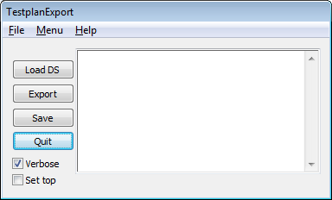

    Testplan Export Tool
Solution
In the test program, we can add some code to save pins’ status of every parameter to data file, and use a software to export these information into excel file.
“TestplanExport.exe” is the software to do this work. Below figure is the outline of the software.

Slide 7
    Testplan Export Tool
Background
Solution
How to use
Appendix

Slide 8
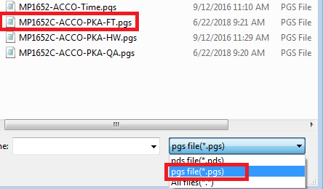
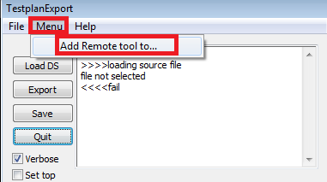
    Testplan Export Tool
How to use
Step 1
Run “testplanexport.exe”, select “Menu”->“add remote tool to…”->“pgs files”/“pds files” to select ACCO/Eagle test program datasheet files
(need backup test program before this operation, it will add some code into your test program)

Slide 9

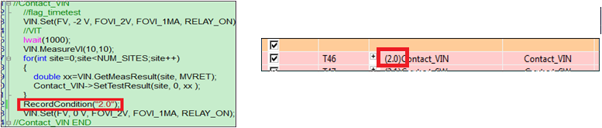
    Testplan Export Tool
How to use
Step 2
Open your test program in vs2005, add function “EnableRecord();” in “contact” function(Call this function only once).
(For Eagle program, software will auto add this code)
Add function “RecordCondition("x.y");”(every parameter need call this function) where your parameter is. "x.y" must same as parameter number in datasheet file!
RecordCondition() have 4 input parameters, only 1st parameter must fill in, another 3 is optional, see note.6

Slide 10
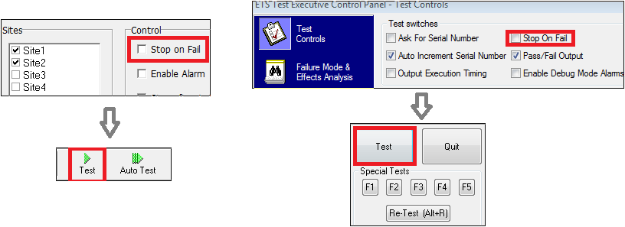
    Testplan Export Tool
How to use
Step 3
Rebuild and Run your test program without stop on fail, every tested parameter will be recorded.
acco eagle

Slide 11
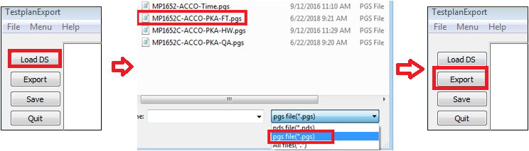
    Testplan Export Tool
How to use
Step 4
Open “TestplanExport.exe”. Click “Load DS” to select pgs/pds in your test program, then click “Export”. Then the software will export testplan.

Slide 12
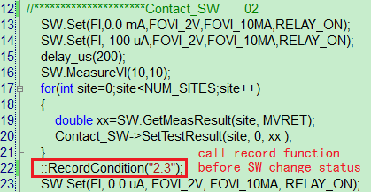
    Testplan Export Tool
Note:
1) RecordCondition("x.y") function will record pins’ status, so need to call this function before condition change, See below figure:
2) For calculated parameter, software can’t highlight measure pin, and can’t export accuracy.
3) In timing test, software can’t mark which PIN to measure.
4) Software will add RecordCondition("x.y") to next line of “groupgetresults(xxxx,NUM_SITES);”, xxxx must be same with parameter name in datasheet file. See below example:

Slide 13
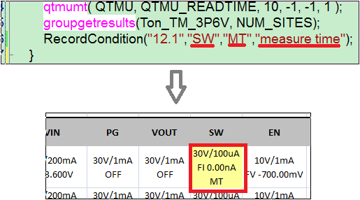
    Testplan Export Tool
Note:
5) Only tested parameter would be recorded, for example, if BV function is disabled, then all parameter of BV will not record;
6)RecordCondition has 4 parameters, if you fill in last 3 parameters, software will export these information to testplan.
For example:

Slide 14
    Testplan Export Tool
Note:
7) For eagle program, make sure config.ets match test program’s requirement, for example, if SP500 is used in test program, so config.ets must have SP500 configuration, you can check in raide.
Any problem or find some bugs, you can contact Hale Shuai (EXT:3412) to solve them.

Slide 15
    Testplan Export Tool
Background
Solution
Case Sharing
How to use
Appendix

Slide 16
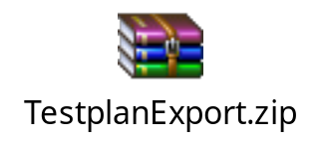
    Testplan Export Tool
Appendix
TestplanExportTool

